Slide 1
Agile Process and Tool Usage

Slide 2
Agile Process
Story Creation
Backlog Grooming
Sprint Planning
Sprint Execution
Showcase

Slide 3
Role Contributions
 | Story Creation | Story Management | Sprint Planning | Sprint Execution | Showcase
Product Owner | O | O |  |  | O
SME | O | O |  |  | O
Analyst | O | O |  | O
PM |  | O | O | O | O
Designer |  |  | O | O
Developer |  |  | O | O
QA |  |  | O | O

Slide 4
Tools
Confluence
Issue Management
Sprint Management
JIRA
Document Storage
Collaboration
Wikis
Agile Board

Slide 5
Confluence
Store documents
Use versions
Comment on content
Store meeting notes

Slide 6
JIRA
Create Issues
Update issue progress
Track issues
Create sprints
Assign issues to sprints
Adjust story ranking (priority)

Slide 7
Issue Types
Definition
Implementation
Requirement
Story
Research
Sub-task
Design
Defect
External Item

Slide 8
Issue Types
Research: Pre-implementation discovery task
Requirement: Pre-implementation definition task
Design: Pre-implementation UX, UI or Eng definition
External: Item for third party implementation
Story: Primary Issue type
Defect: Item denoting deficiency
Sub-task: Created by individual user, no validation

Slide 9
Workflows
Advance issues through statuses
Use workflow buttons in issue detail view or Drag in Agile board across columns
Your interaction is limited to what you’ve done, not where it goes next
Make at least one workflow change per day

Slide 10
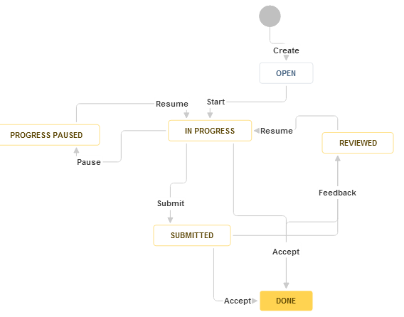
Planning Workflow

Slide 11
Planning Workflow
Applies to Requirement, Design, Research, External Item
“Start” when you begin work
This sets assignee
“Pause” if you are unable to progress
“Resume” when ready
“Submit” when ready for review
“Accept” or “Feedback” after reviewing

Slide 12
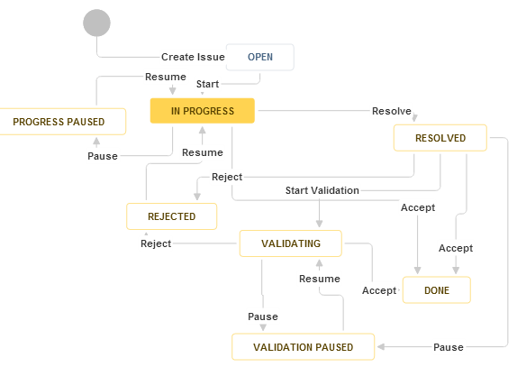
Story, Defect Workflows

Slide 13
Story, Defect Workflows
Applies to Story, Defect
Start when you being work
“Pause” if you are unable to progress
“Resume” when unblocked
“Resolve” when implemented
“Accept” or “Reject” after validating

Slide 14
Issue Routing
Uses a self-service model
Principally done with Status and Resolver Role
“Start” any issue that is assigned to your role This designates you as the Assignee
The assignee generally remains unchanged throughout the lifetime of an issue

Slide 15
Issue Routing
All Paused (Blocked) items are reviewed at least daily
PM accountable for unblocking
Any team member can unblock
“New” defects must be Approved by triage resource, then assigned to a Sprint before they are assumable by a resource for resolution

Slide 16
JIRA Dashboards
Role-specific
Active sprint items only
“My Owned” - assigned to you, but may not be actionable
“Assumable” - Resolver Role set to your sub-team
“Watched and Mentioned” - issues you are watching or have been mentioned in - use “@“ symbol then user name in any long text field

Slide 17
Agile Boards
Use Work View
A grid view of the issues in the current sprint
Can use drag and drop to advance issues through workflow status
All issues must move to the Done column before a sprint can close

Slide 18
Waterfall to Agile Translation
Priority – Ranking
Test Case – Acceptance Criteria
Out of Scope – (in backlog)
Requirement – doc sections, linked to within a story
Func Spec – doc sections, linked to within a story

Slide 19
Final Slide
What you must do…
…is clear your dashboard queue
…from top to bottom

Slide 20
Comments and Questions
(this area intentionally left blank)

